Slide 1



Credit Risk Analysis
Group 3
12111032班岳廷 12011331汪海玉
11911214杨鸿嘉 11911303吉辰卿

Slide 2


01
German Credit Risk
11911214 杨鸿嘉

Slide 3
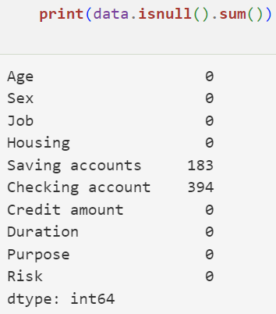

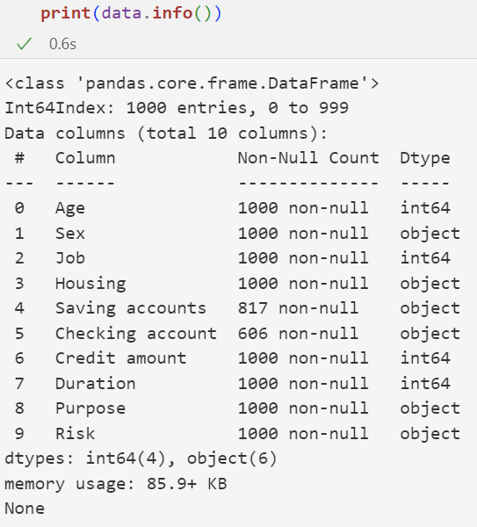
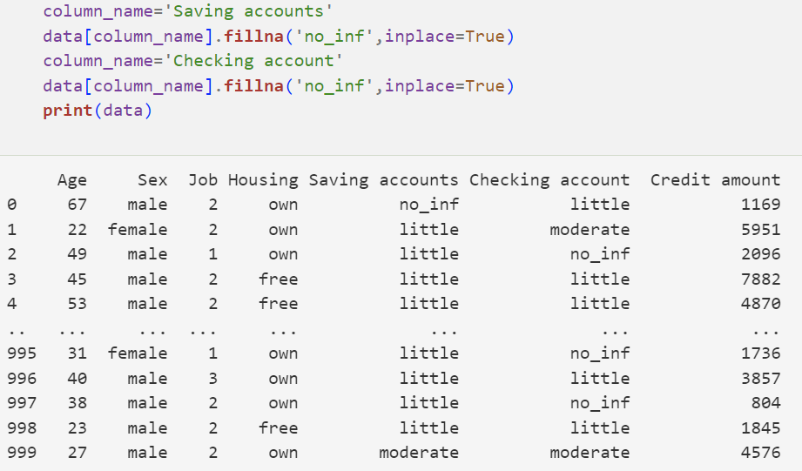
Data Analysis
Data type, check missing data
血清内铂添加回收实验及方案可靠性验证

Slide 4
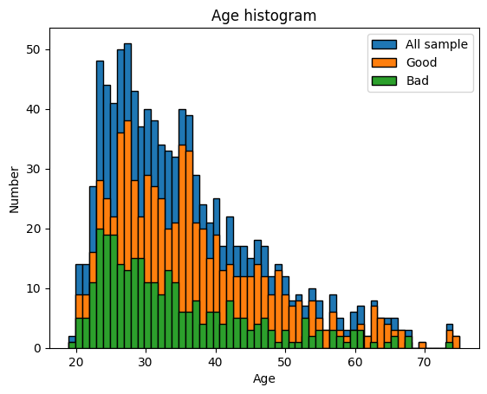
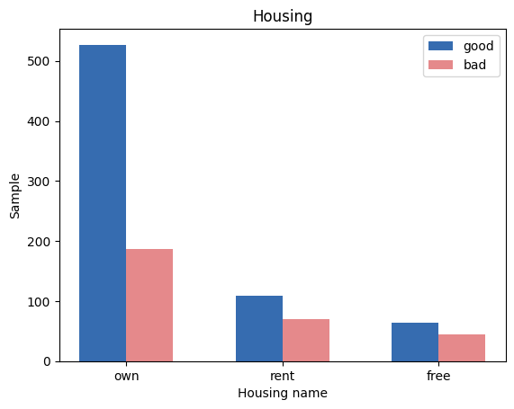
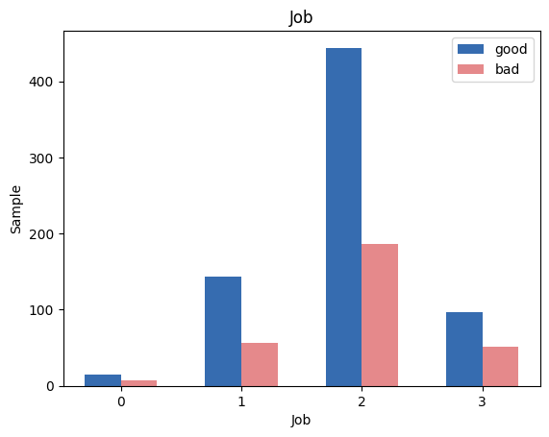
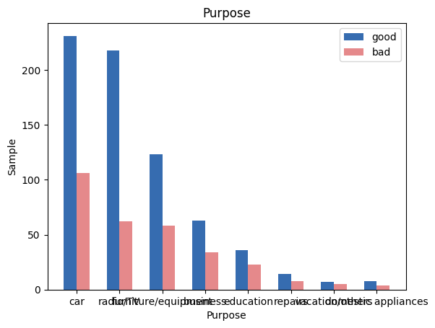
Data Analysis
plot the relationship of Risk and other parameters
血清内铂添加回收实验及方案可靠性验证

Slide 5
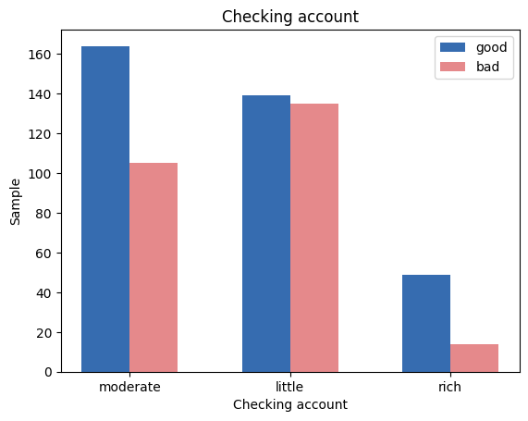
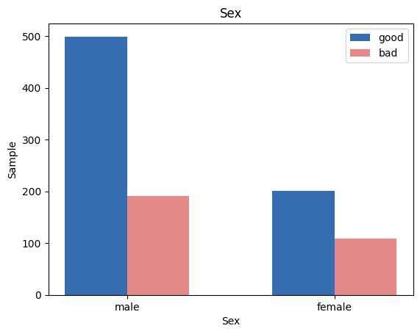
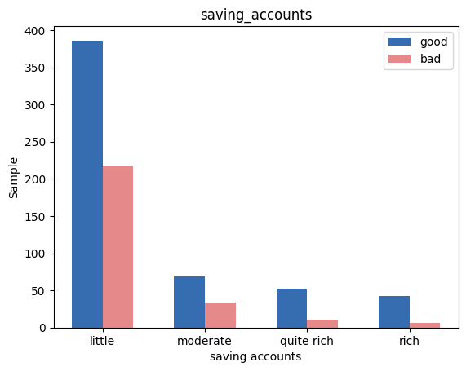
Data Analysis
plot the relationship of Risk and other parameters
血清内铂添加回收实验及方案可靠性验证

Slide 6
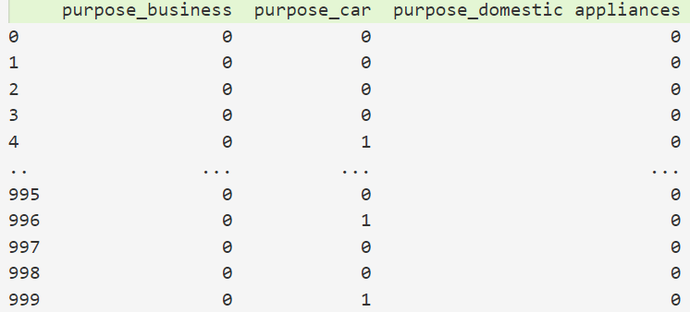
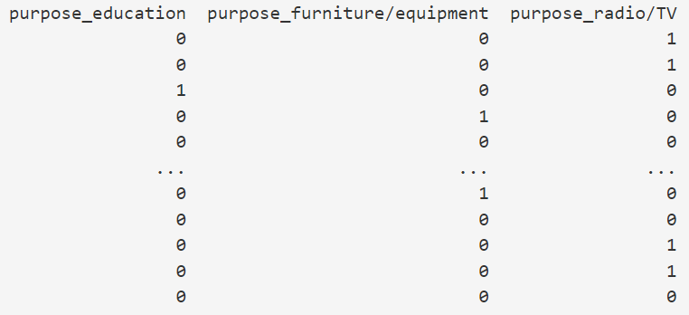
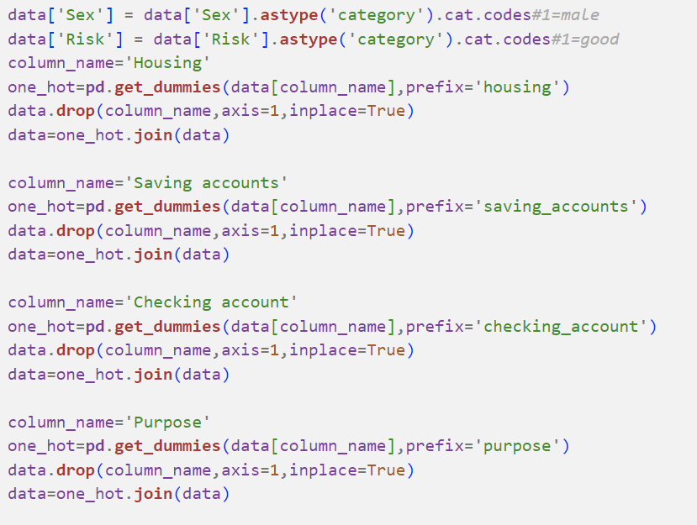
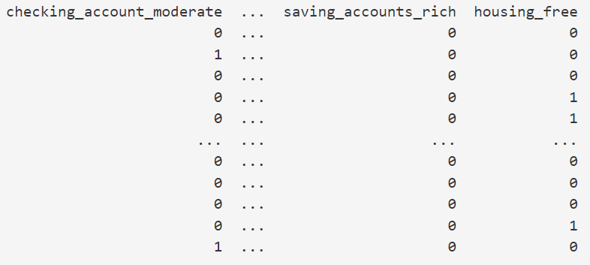
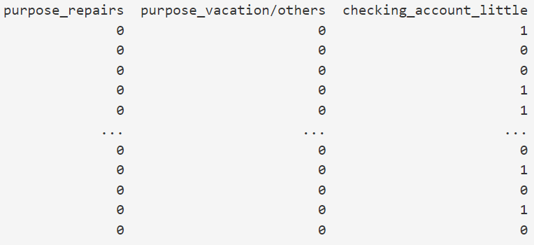
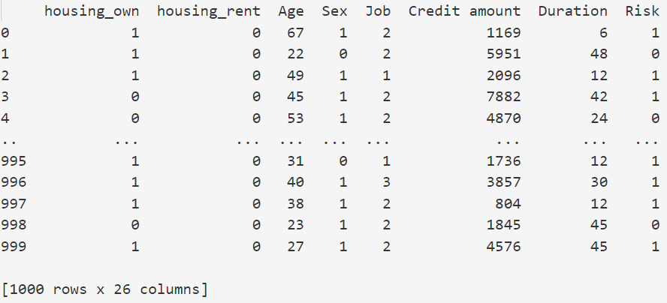
Data Analysis
one-hot coding for non-numerical data
血清内铂添加回收实验及方案可靠性验证

Slide 7
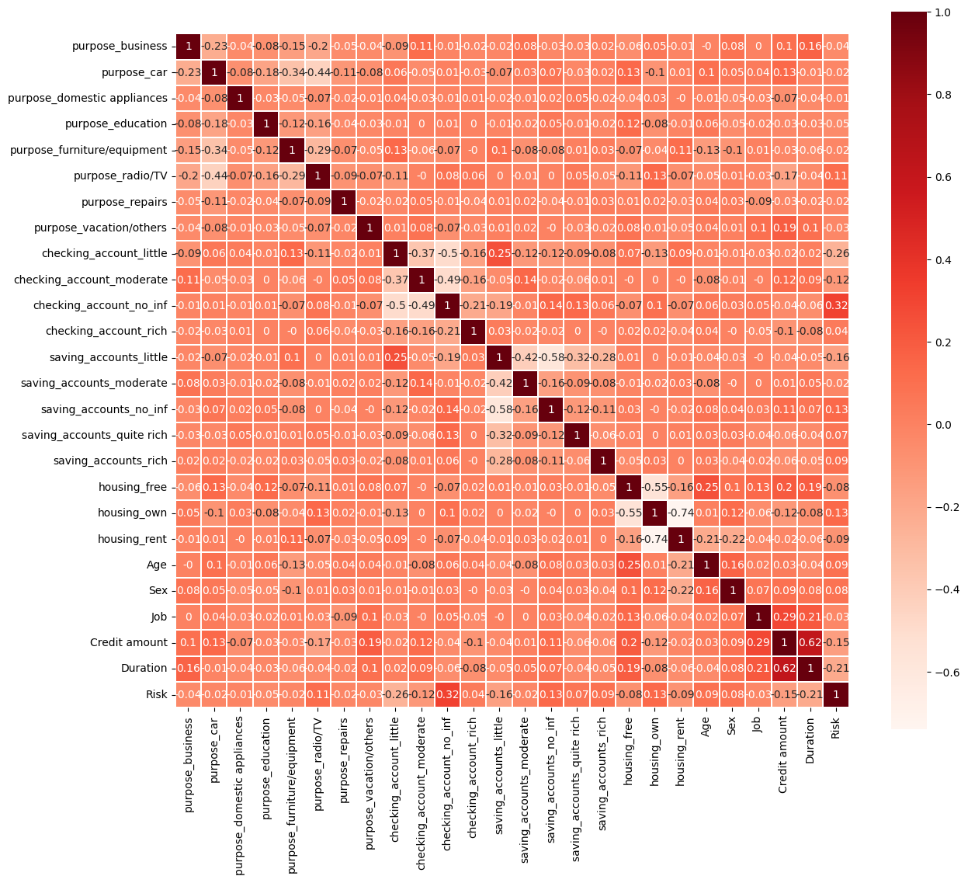
Data Analysis
relationship between each data
血清内铂添加回收实验及方案可靠性验证

Slide 8
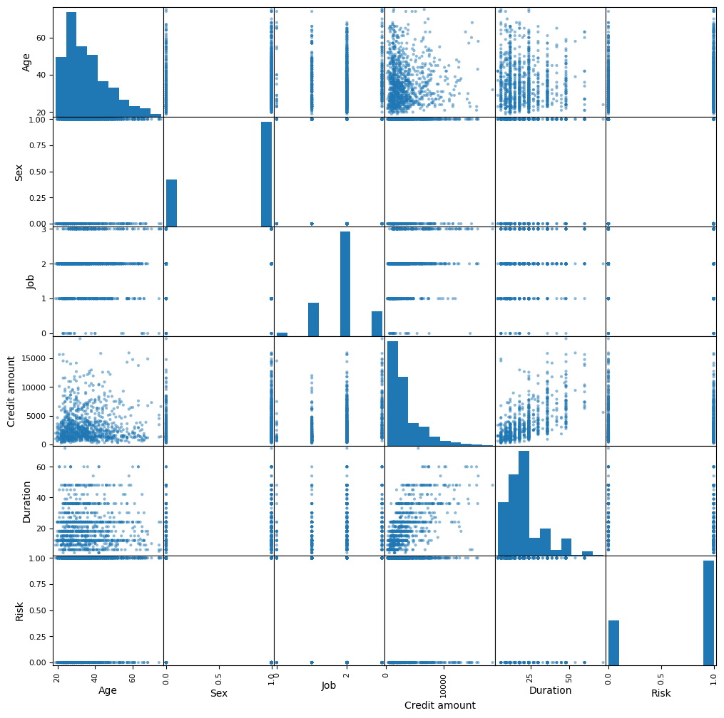
Data Analysis
relationship between each data
血清内铂添加回收实验及方案可靠性验证

Slide 9
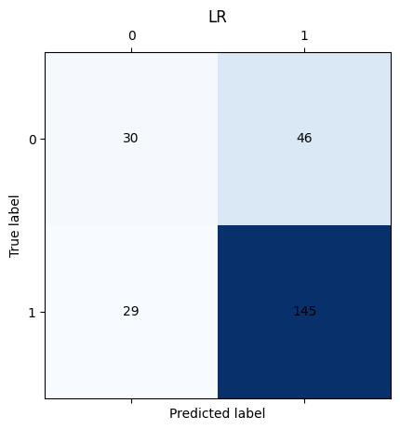

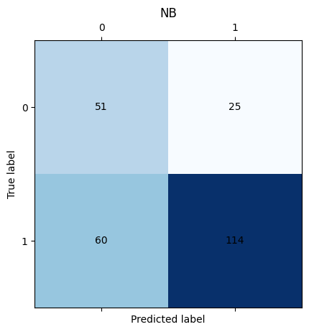
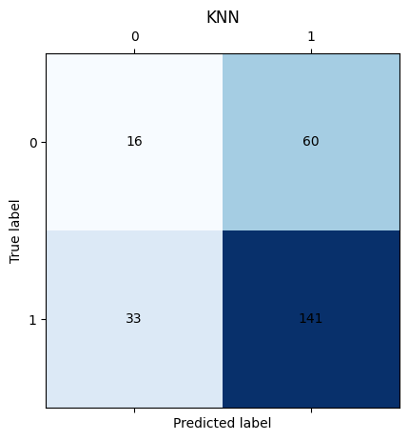
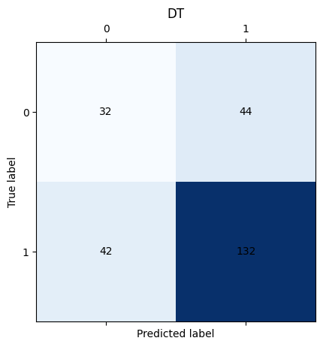
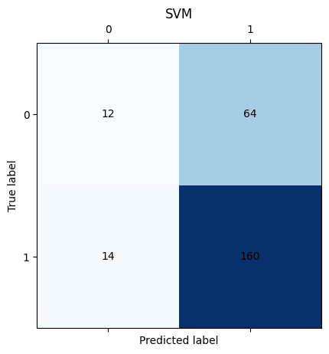
Result of Mechine Learning Algorithm
Notes:
以逻辑回归为主
结合随即森林和KNN来分析对于MNIST数据集的分类效果

Slide 10
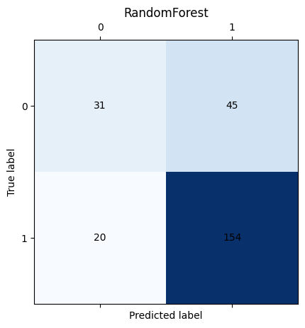
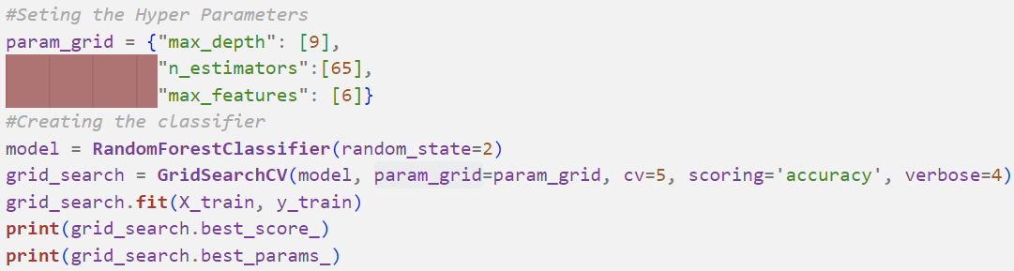
Result of Mechine Learning Algorithm
Parameters Selection for Random Forest Algorihtm:
max_depth=9
max_feature=6
n_estimators=65
Notes:
以逻辑回归为主
结合随即森林和KNN来分析对于MNIST数据集的分类效果

Slide 11
Result of Mechine Learning Algorithm
Without K-fold on test data
LogisticRegression
LinearDiscriminantAnalysis
KNeighborsClassifier
DecisionTreeClassifier
GaussianNB
SVC
RandomForest
Accuracy F1 Recall
0.700 0.795 0.833
0.700 0.788 0.799
0.628 0.752 0.810
0.656 0.754 0.759
0.660 0.728 0.655
0.688 0.804 0.920
0.740 0.826 0.885
Notes:
以逻辑回归为主
结合随即森林和KNN来分析对于MNIST数据集的分类效果

Slide 12
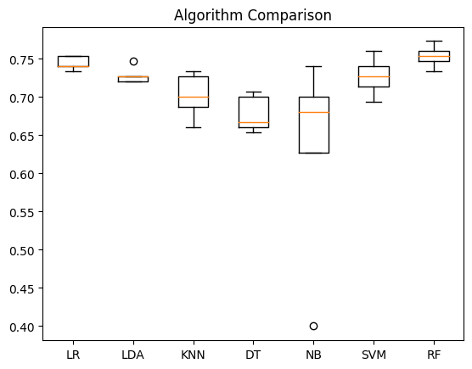
Result of Mechine Learning Algorithm
With K-fold=5
LogisticRegression
LinearDiscriminantAnalysis
KNeighborsClassifier
DecisionTreeClassifier
GaussianNB
SVC
RandomForest
Accuracy
0.744000
0.728000
0.701333
0.677333
0.629333
0.726667
0.753333
Notes:
以逻辑回归为主
结合随即森林和KNN来分析对于MNIST数据集的分类效果

Slide 13
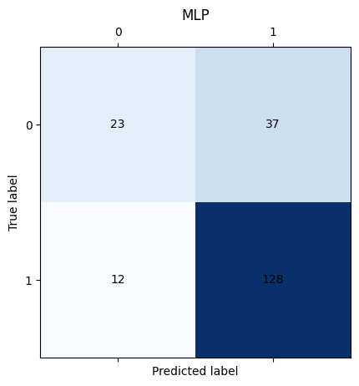
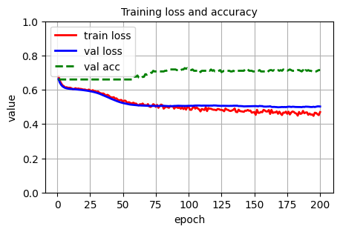
Result of Deep Learning Algorithm
SGD
Cosine Decay
batchsize=64
init=Uniform
loss=CrossEntropyLoss
MLP
LogisticRegression
LinearDiscriminantAnalysis
KNeighborsClassifier
DecisionTreeClassifier
GaussianNB
SVC
RandomForest
MLP
Accuracy F1 Recall
0.700 0.795 0.833
0.700 0.788 0.799
0.628 0.752 0.810
0.656 0.754 0.759
0.660 0.728 0.655
0.688 0.804 0.920
0.740 0.826 0.885
0.755 0.839 0.914
Input
(n,25)
FC
FC
Relu
Relu
Dropout
Dropout
FC
(0.4)
(0.2)
血清内铂添加回收实验及方案可靠性验证
(n,24)
(n,16)
(n,2)
Notes:
以逻辑回归为主
结合随即森林和KNN来分析对于MNIST数据集的分类效果

Slide 14
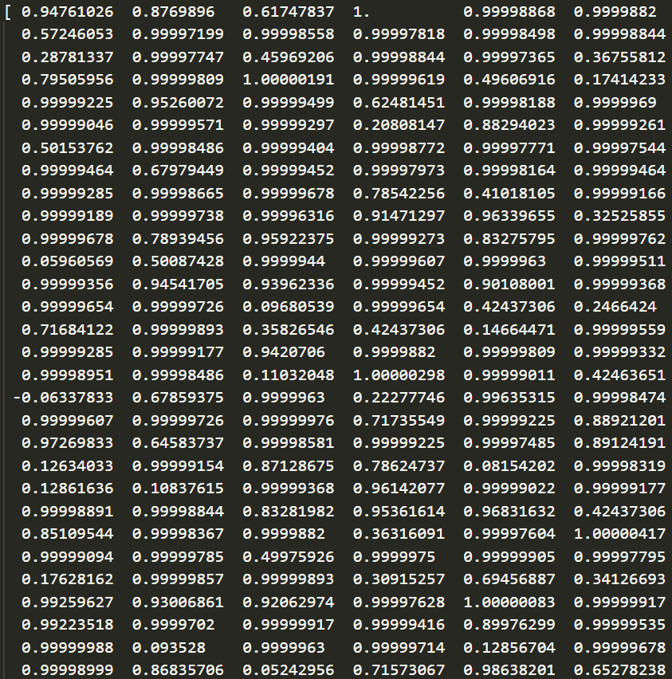
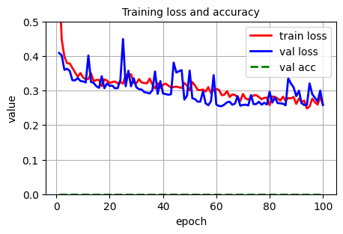
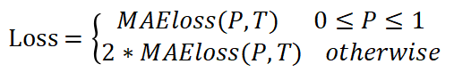
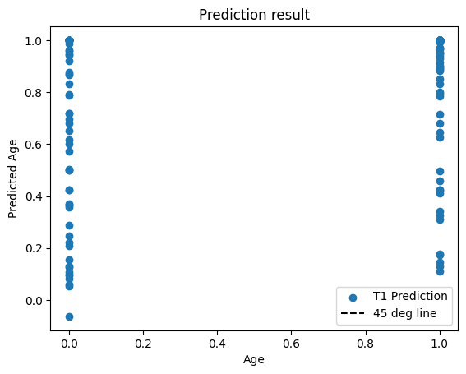
Result of Deep Learning Algorithm
AdamW
Cosine Decay
batchsize=64
init=Uniform
loss=MAEloss
Validation MAE: 0.25542991496622564
血清内铂添加回收实验及方案可靠性验证

Slide 15
02
ML for UCI_Credit_Card dataset
12111032班岳廷
11911303吉辰卿
12011331汪海玉

Slide 16
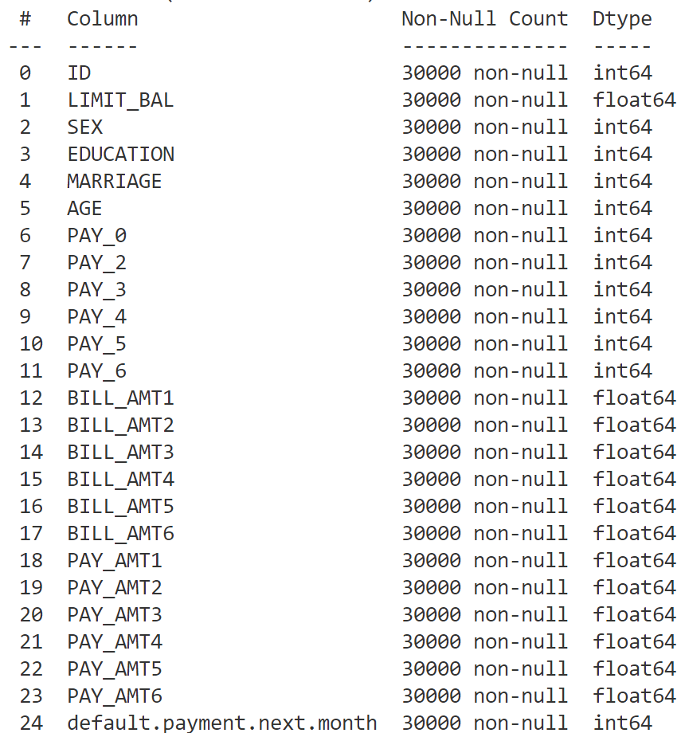
1.Data introduction
Default of Credit Card Client Dataset
The data set contains default information of a bank's credit card department from April to Sep.
Feature : 24 (include ID)
Label : 1 (default or not)
The task is to predict user defaults using models and evaluation
Notes:
以逻辑回归为主
结合随即森林和KNN来分析对于MNIST数据集的分类效果

Slide 17
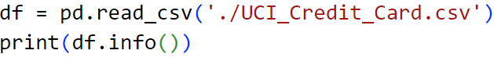
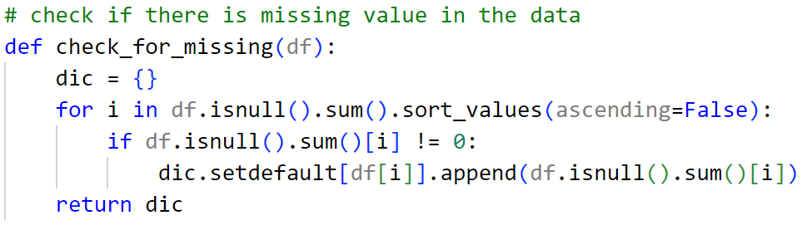
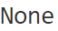
2. Data cleaning
(1) Load data
(2) Missing value check

Slide 18
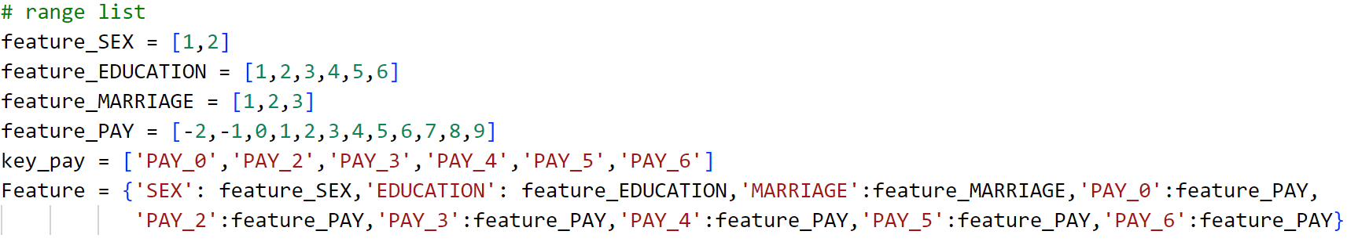
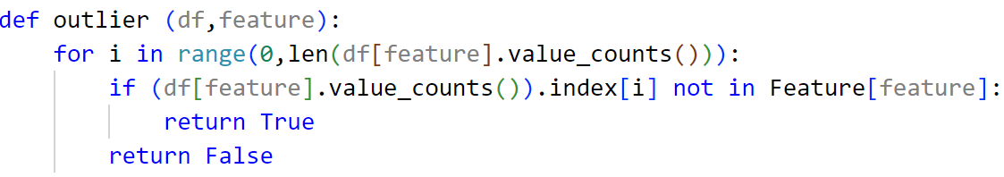
2.Data cleaning
(3) Outlier

Slide 19
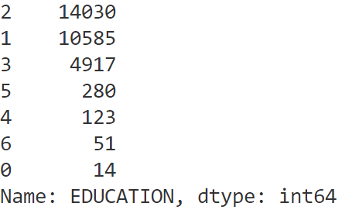
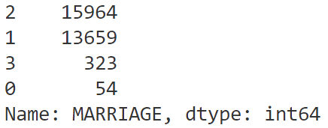
2.Data cleaning
(4) Data operation
EDUCATION :
MARRIAGE:

Slide 20
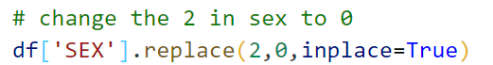
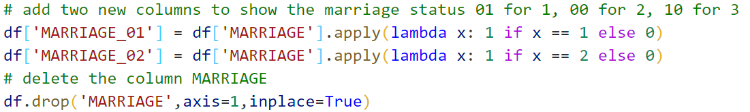
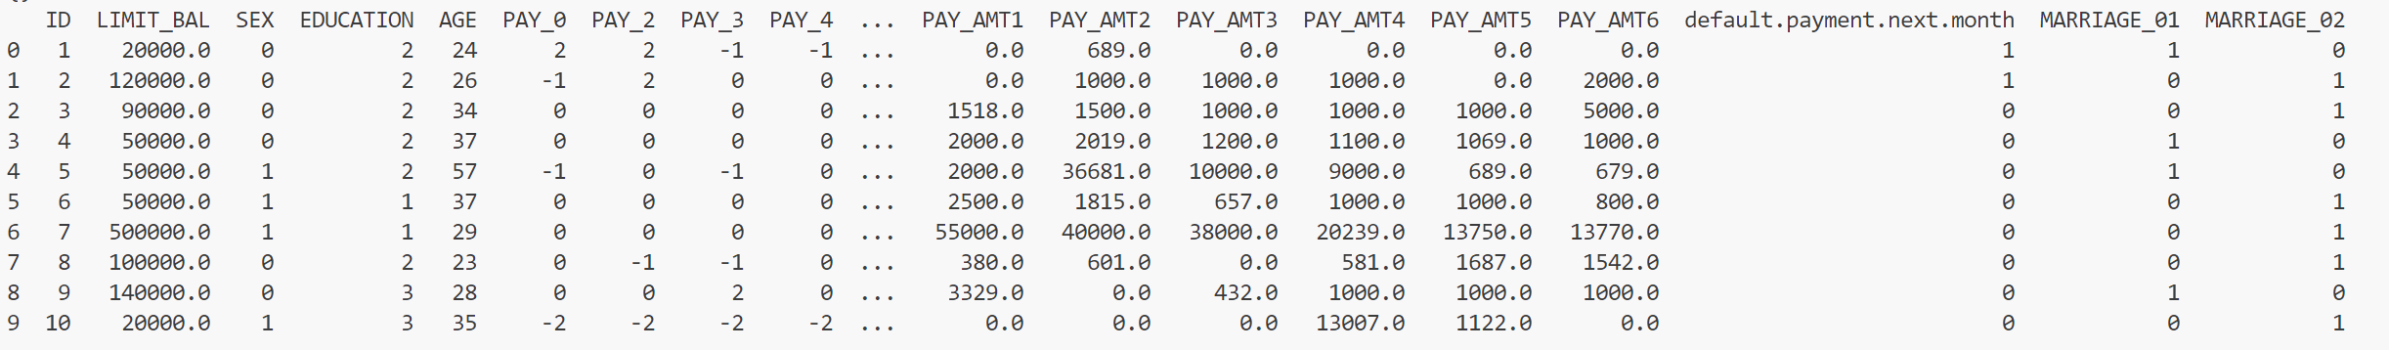
2. Data cleaning

Slide 21
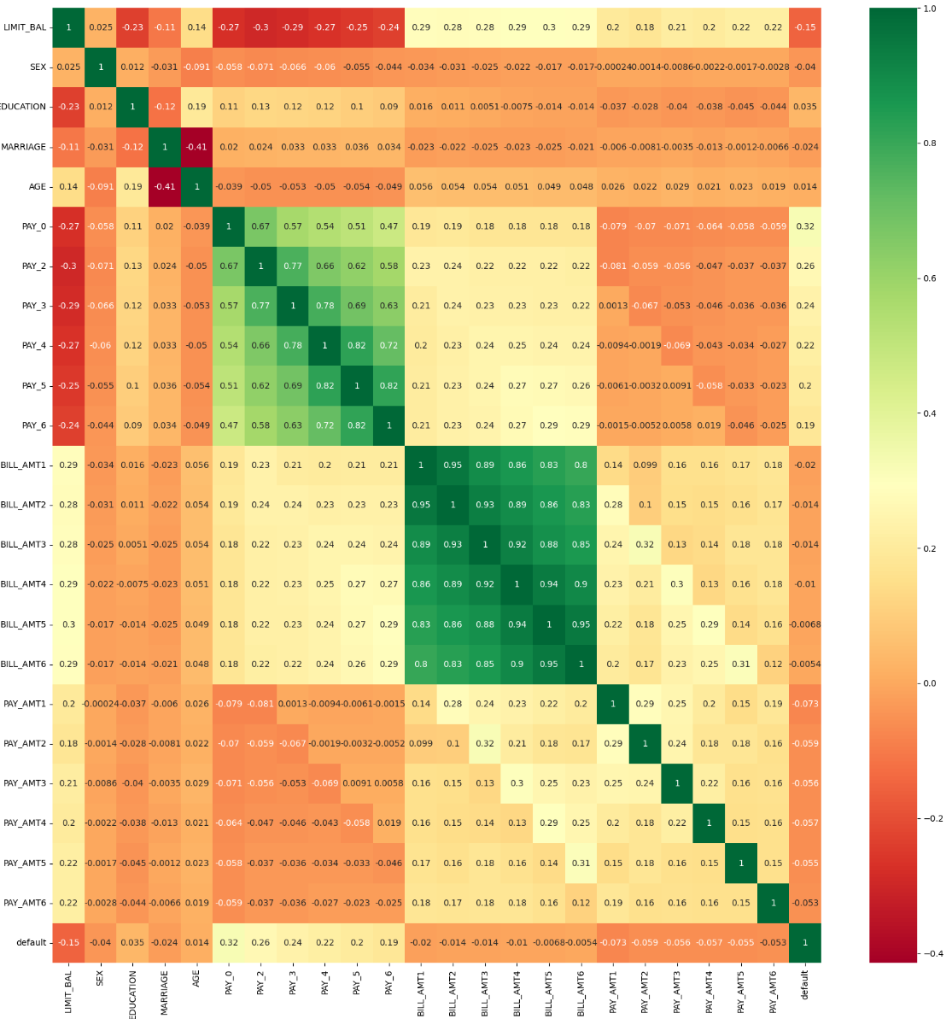
3.Feature selection
(1) Correlation matrix

Slide 22
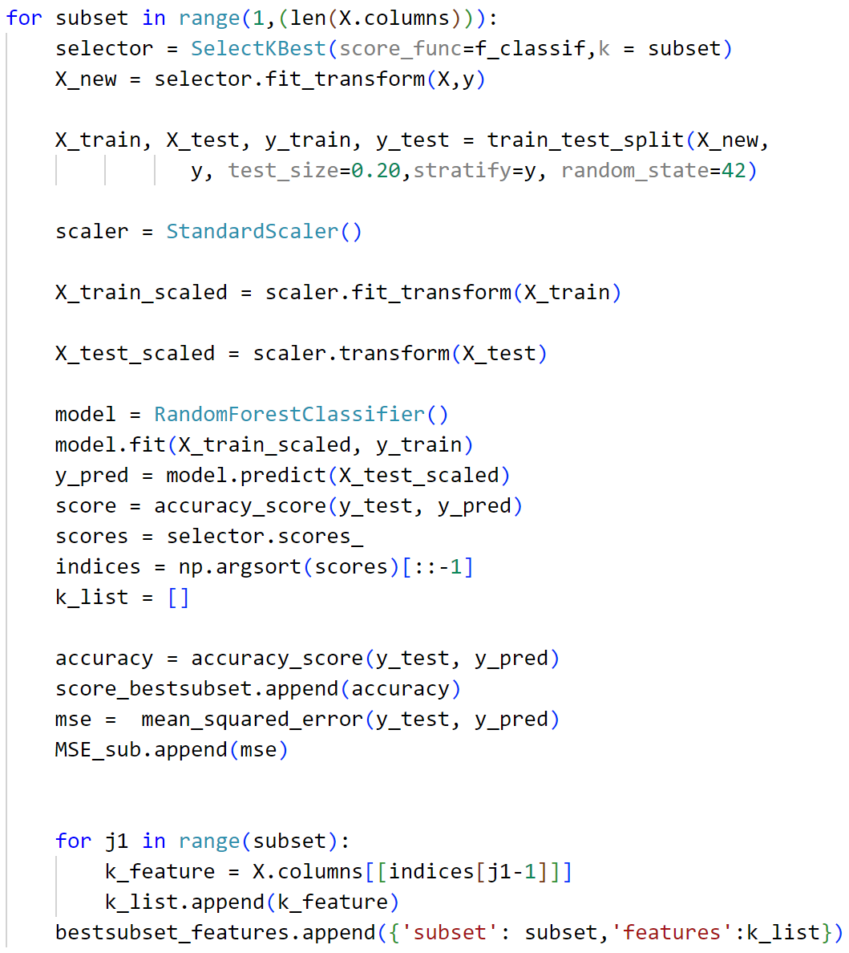
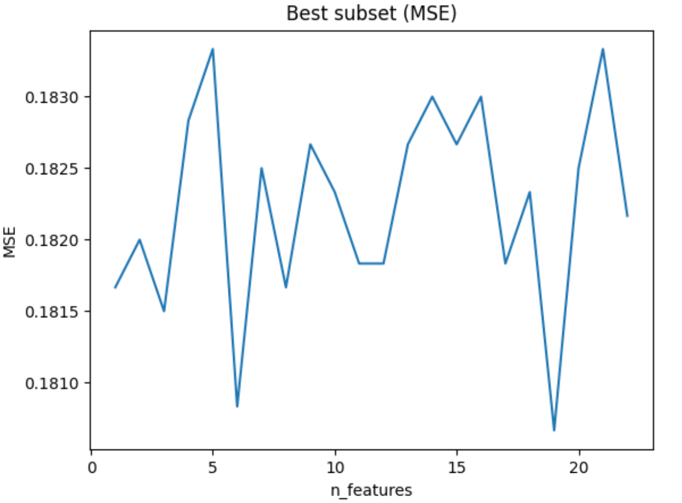
3.Feature selection
(2) Best subset
{'subset': 19, 'features': [Index(['BILL_AMT6'], dtype='object'), Index(['PAY_0'], dtype='object'), Index(['PAY_2'], dtype='object'), Index(['PAY_3'], dtype='object'), Index(['PAY_4'], dtype='object'), Index(['PAY_5'], dtype='object'), Index(['PAY_6'], dtype='object'), Index(['LIMIT_BAL'], dtype='object'), Index(['PAY_AMT1'], dtype='object'), Index(['PAY_AMT2'], dtype='object'), Index(['PAY_AMT4'], dtype='object'), Index(['PAY_AMT3'], dtype='object'), Index(['PAY_AMT5'],
dtype='object'), Index(['PAY_AMT6'], dtype='object'), Index(['SEX'], dtype='object'), Index(['EDUCATION'], dtype='object'), Index(['MARRIAGE'], dtype='object'), Index(['BILL_AMT1'], dtype='object'), Index(['BILL_AMT2'], dtype='object')]}
Accuracy : 0.8193333333333334

Slide 23
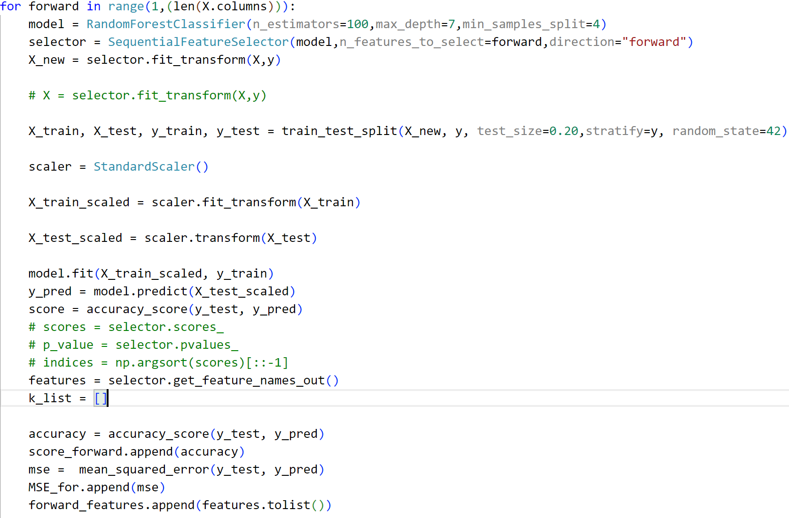
3.Feature selection
(3) Forward and backward

Slide 24
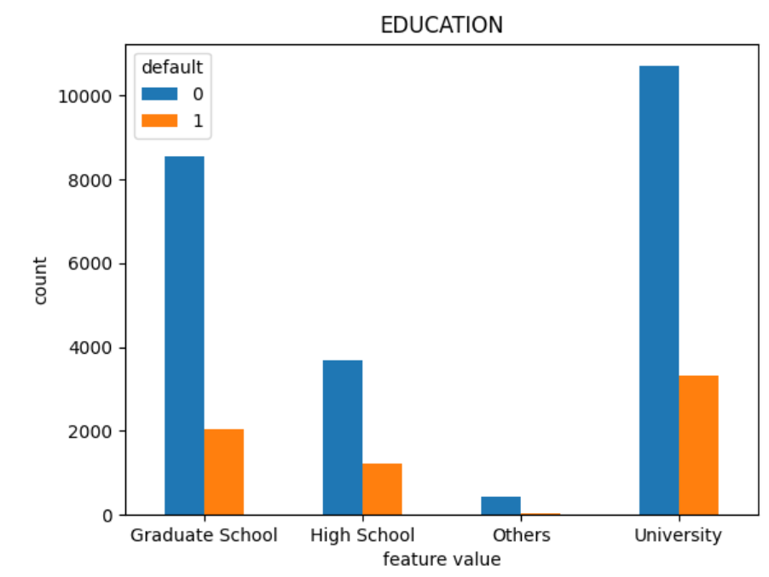
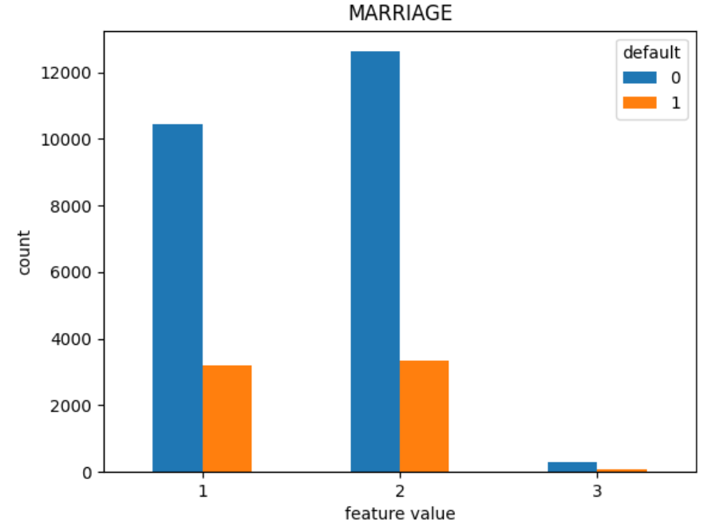
4.Visualization
MARRIAGE
EDUCATION

Slide 25
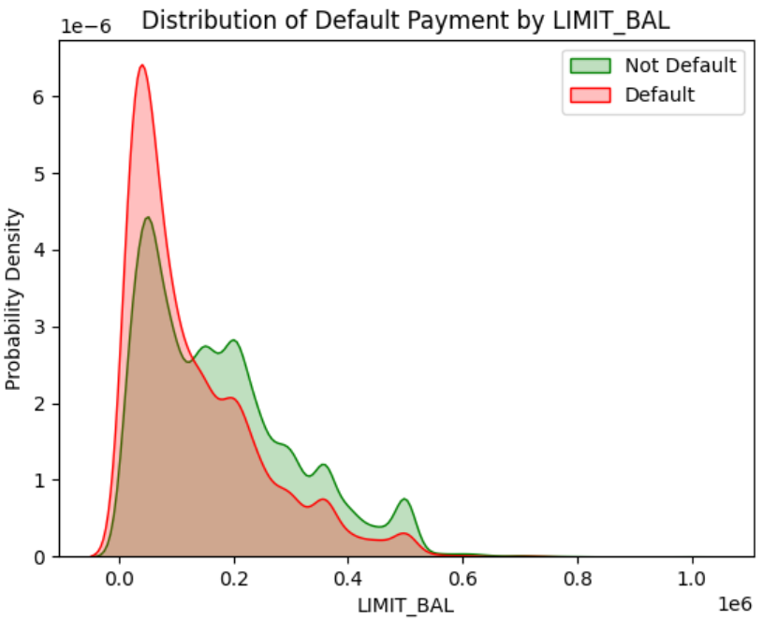

4.Visualization
LIMIT_BAL
Bill_ATM 1

Slide 26

5.Preprocessing
Standard Scaler

Slide 27


6.Training process

Slide 28



7.Result
(1) Accuracy , time , F1 and recall

Slide 29




7.Result
(2) confusing matrix

Slide 30




7.Result
(3) cross validation
Over fitting

Slide 31


7.Result
(4) feature importance comparison

Slide 32


7.Result
(5) RF parameter selection
Better model :
n_estimators=100,
max_depth=7,
min_samples_split=4,
min_samples_leaf=3
Accuracy : 0.832

Slide 33


7.Result
(6) model ensemble – hard voting
The ensemble learning method determines the final classification result by voting the predicted results of different classifiers

Slide 34

7.Result
(6) model ensemble – stacking
The basic idea of Stacking is to use multiple different base classifiers and use a meta-classifier to combine the output of these base classifiers to improve forecasting accuracy

Slide 35

7.Result
(7) test size

Slide 36



8.Neural Network
(1)Multilayer Perceptorn, MLP
Pre-processing
# read the data
data = pd.read_csv('UCI_Credit_Card.csv') # glimpse at the data
data.head()
data.info() # 2.数据清洗
# relabel EDUCATION information
fil = (data.EDUCATION == 5) | (data.EDUCATION == 6) | (data.EDUCATION == 0)
data.loc[fil, 'EDUCATION'] = 4 # relabel MARRIAGE information
data.loc[data.MARRIAGE == 0, 'MARRIAGE'] = 3 # rename column
data = data.rename(columns={'default.payment.next.month':'def_pay','PAY_0':'PAY_1'})

Slide 37

8.Neural Network
(1)Multilayer Perceptorn, MLP
Network Structure
MLP
Parameter initialization
Input
(n,23)
FC
FC
Relu
Relu
Dropout
Dropout
FC
(0.4)
(0.2)
(n,22)
(22,16)
(16,2)

Slide 38

8.Neural Network
(1)Multilayer Perceptorn, MLP
Loss Function
loss = nf.cross_entropy(outputs, targets)
Optimizer

Slide 39


8.Neural Network
(1)Multilayer Perceptorn, MLP
Training and verification process and classification confusion matrix

Slide 40

8.Neural Network
(2) Convolutional Neural Network, CNN

Slide 41

8.Neural Network
(2) Convolutional Neural Network, CNN
Network Structure
CNN
Input
(n,1,23)
Conv1d
FC\Relu
Relu
Maxpool1d
Maxpool1d
FC\Relu
Conv1d
Relu
(1,10)
(10,20)
(20,2)
(460,20)

Slide 42
8.Neural Network
(2) Convolutional Neural Network, CNN
Loss Function
loss = nf.cross_entropy(outputs, targets)
Parameter initialization
Optimizer

Slide 43


8.Neural Network
(2) Convolutional Neural Network, CNN
Training and verification process and classification confusion matrix

Slide 44
8.Neural Network
(2) Convolutional Neural Network, CNN
Overall statistics in dataset2
LogisticRegression
LinearDiscriminantAnalysis
KNeighborsClassifier
DecisionTreeClassifier
GaussianNB
SVC
RandomForest
CNN
MLP
Accuracy F1 Recall
0.700 0.795 0.833
0.700 0.788 0.799
0.628 0.752 0.810
0.656 0.754 0.759
0.660 0.728 0.655
0.688 0.804 0.920
0.740 0.826 0.885
0.818 0.461 0.351
0.819 0.475 0.370

Slide 45


8.Neural Network
Our thinking
(2) Convolutional Neural Network, CNN
Unbalanced Dataset
Inaccurate parameter
Incorrect Pre-processing
Right
Wrong

Slide 46
感谢各位专家!
Q&A

